Slide 2
Black Swan
Ohio SET 2017

Slide 3
Black Swan
BLACK SWAN will coordinate local organizations’ participation from 1-15 October 2017,
with participating organizations’ operational periods not to exceed 48 hours. Local choice of
participating time period should be guided by availability and organization mission relative to the
timeline.
(1) “Build-Up” is the period of 1-6 October, where organizations involved in
preparation for large events, or in response to localized emergencies may wish to participate.
(2) “Intense Action” is the period of 7-8 October, where most organizations will be
establishing operating stations and handling radio traffic in support of preparation for, response to, and recovery from emergencies.
(3) “Recovery” is the period of 9-15 October, where organizations preparing for and
engaged in recovery operations may wish to participate.

Slide 4
Black Swan
This exercise structure is meant to support all amateur radio group SET functions
throughout the Ohio Section.
(1) Amateur Radio Emergency Service (ARES) organizations and Official Emergency
Stations (OESes) are encouraged to exercise their Standard Operating Procedures (SOPs) and
Communications Plans, including in support of served agencies.
(2) National Traffic System (NTS) and Radio Relay International (RRI) affiliated
affiliated traffic nets are encouraged to exercise their SOPs and plans in support of served agencies
and the public.
(3) Independent traffic nets and Official Relay Stations (ORSes) are also encouraged to
participate by originating, relaying, and delivering exercise traffic.
(4) Participating organizations should establish special sessions of their nets as
needed to support operations within the context of the scenario.
(5) Traffic stations in particular should monitor their “watch frequencies” to ensure
that TEST EMERGENCY and TEST PRIORITY traffic can move outside of published skeds.

Slide 5
Black Swan
a. The exercise scenario calls for a group of strong storms that converge into a supercell that
brings severe weather through an area of the U.S. ranging from Iowa to Ohio. Bringing strong winds
and heavy rain bring significant structural damage and flooding that both overwhelm local
responders and impede response efforts.
b. Response will necessarily include the use of secondary and tertiary forces, typically trained
and configured for a particular type of response and to communicate with other members of their
own forces. Without reliable phone or Internet service in the affected area, the public and
responders lack the usual communication capabilities. What circuits are available are overwhelmed
and unreliable, leaving only simplex and operation from field-expedient infrastructure erected
during the exercise.

Slide 6
Black Swan
(1) Severe damage to buildings, communications towers, and other infrastructure;
(2) Widespread power outages;
(3) Widespread communications outages; and
(4) Severe flooding.
d. Responses include:
(1) Activation of county and state emergency operations centers for coordination and
(2) Activation of civilian, military, and NGO units to conduct operations, including but
not limited to damage assessment, light search and rescue, temporary shelters, volunteer
reception centers, and points of distribution.
e. Capabilities to test include:
(1) Voice communication within the county using FRS, GMRS, Amateur, and Other
services as appropriate;
(2) Voice communication between county and state EMAs using Amateur and Other
services as appropriate;
(3) Amateur radio operation in other allowed modes, namely CW (Morse Code), and
Digital; and
(4) Interoperability between amateur and government stations.

Slide 7
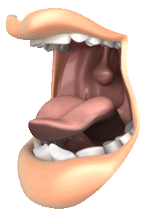
Black Swan
With all the pressure, what’s a lonely EC to do??

Slide 8
Black Swan
https://sites.google.com/view/blackswan/2017

Slide 9
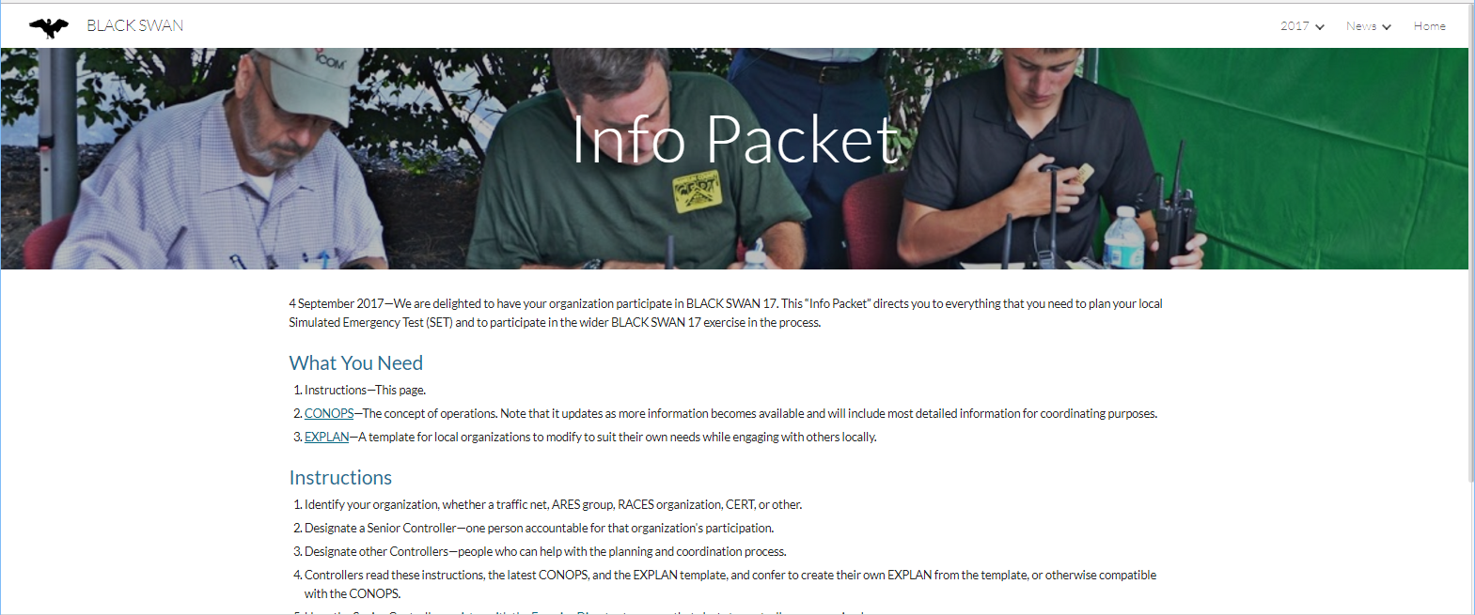
Black Swan
https://sites.google.com/view/blackswan/2017

Slide 10
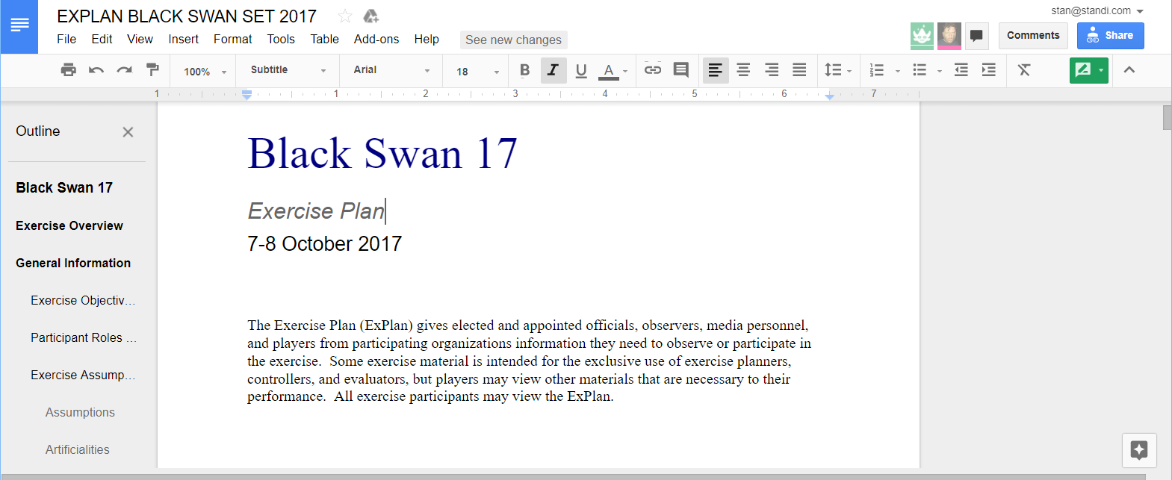
Black Swan
https://sites.google.com/view/blackswan/2017

Slide 11
Black Swan
https://sites.google.com/view/blackswan/2017

Slide 12
Black Swan
Appendix A has a generic timetable, some adaptable injects that each EC can use as a skeleton. Additional injects and activities should be added to shape the local county’s disaster and reaction.

Slide 13
Then, it’s time to rally the troops, make your assignments, deploy, send and receive traffic!

Slide 14
Test your plan, and execute your activities to handle the situation!

Slide 15
At the end of the op period, hotwash and congratulate everyone- job well done!

Slide 16
What does it take to win?
Design local injects that would reasonably take place (Review Central OH history)
Activate – and STAY BUSY with assignments, developing situations
Earlier: Callup, Checkin, call it a wrap and go home
To be prepared for real life:
TRAIN for real life!
Traffic intensive- local, district, state, national/international
“This is a test message”

Slide 17
What does it take to win?
IMPORTANT!!
Create your After Action Report
FILE YOUR SET REPORT WITH ARRL!!

